Slide 1
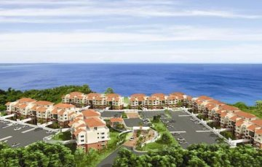
‘’Paseos Del Atlantico”
The Enchanted Island
Aguadilla, Puerto Rico

Slide 2
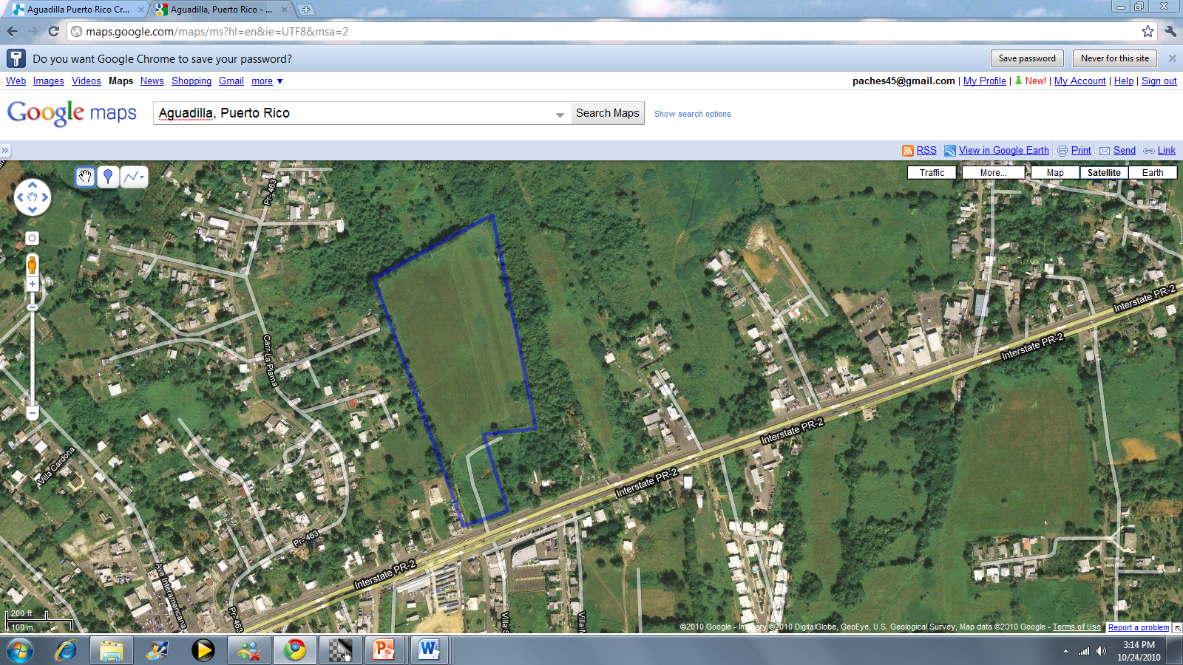
Paseos Del Atlantico Project

Slide 3
Size - 37.3 Cuerdas or 36.2 Acres.
Zoning - Agriculture ( can be changed easily)
Permits – The Planning and Project Administration office of the Municipality of Aguadilla has endorsed the development proposal of 260 residences and 49,000 square feet of commercial area and has named it “Paseos del Atlantico”.
Actual Use - Vacant – raw land.
Best Use - Residential, Commercial, Selective development.
Facilities - Adjacent to the property.

Slide 4
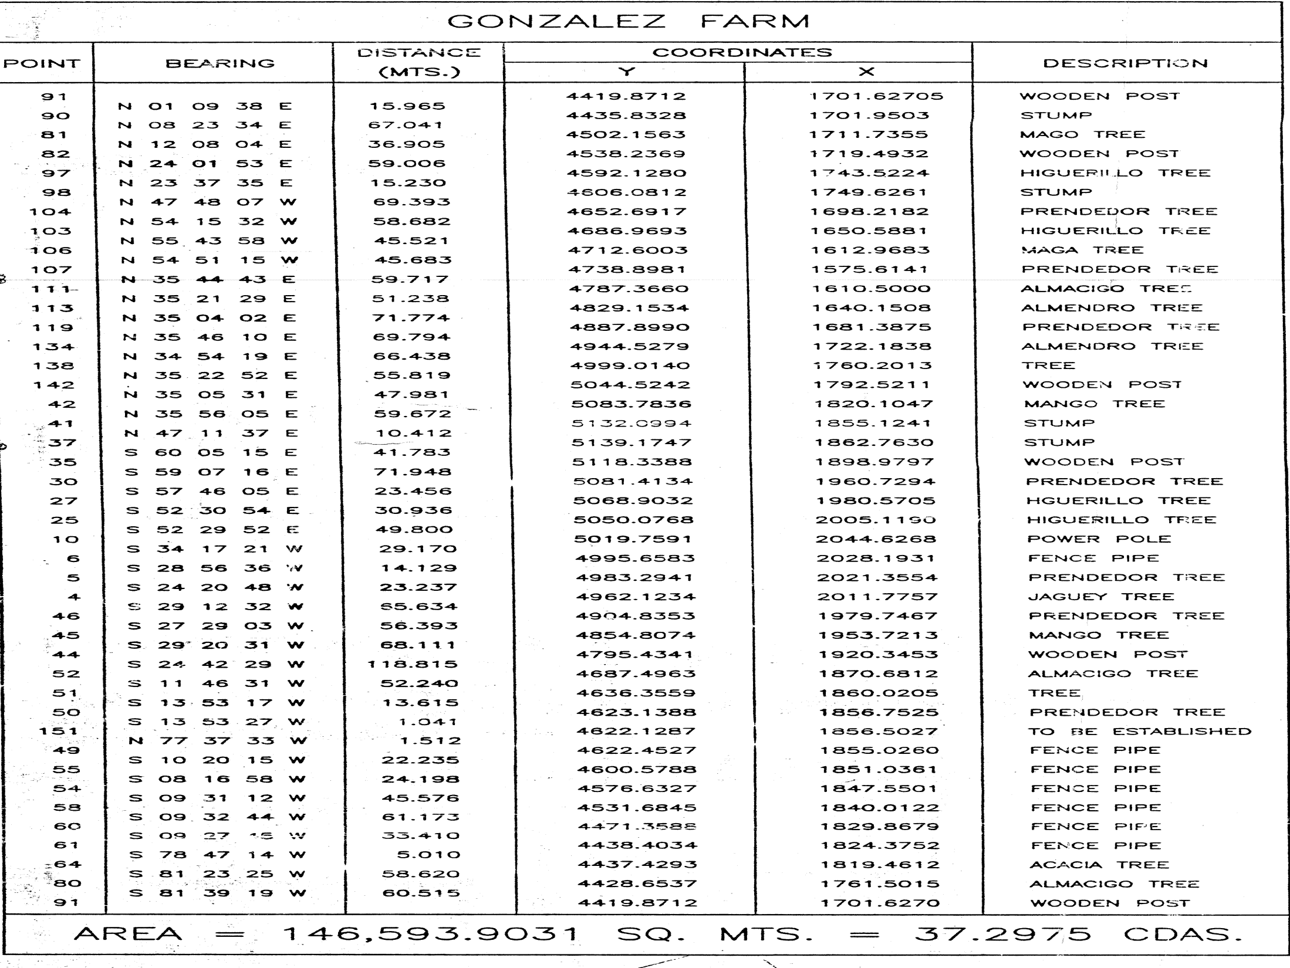

Slide 5
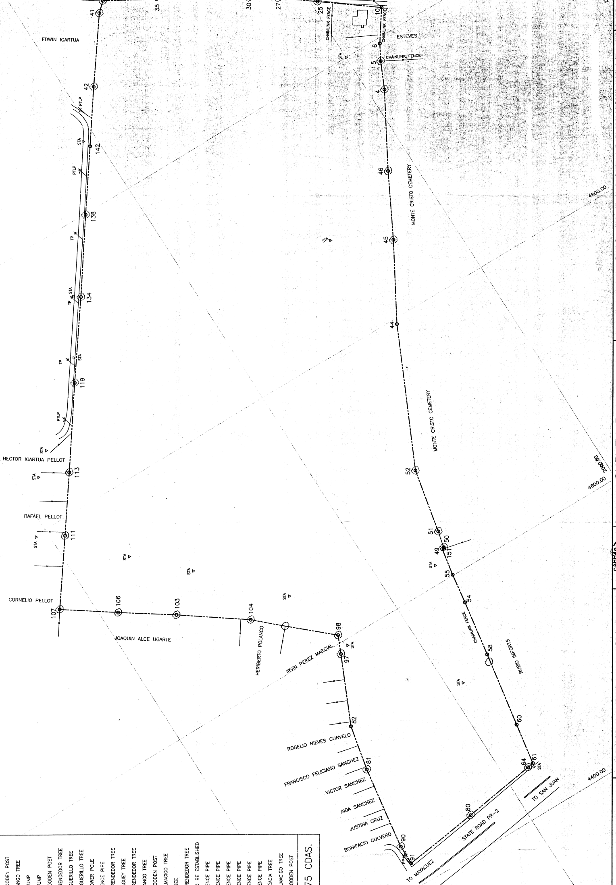
Survey plan

Slide 6
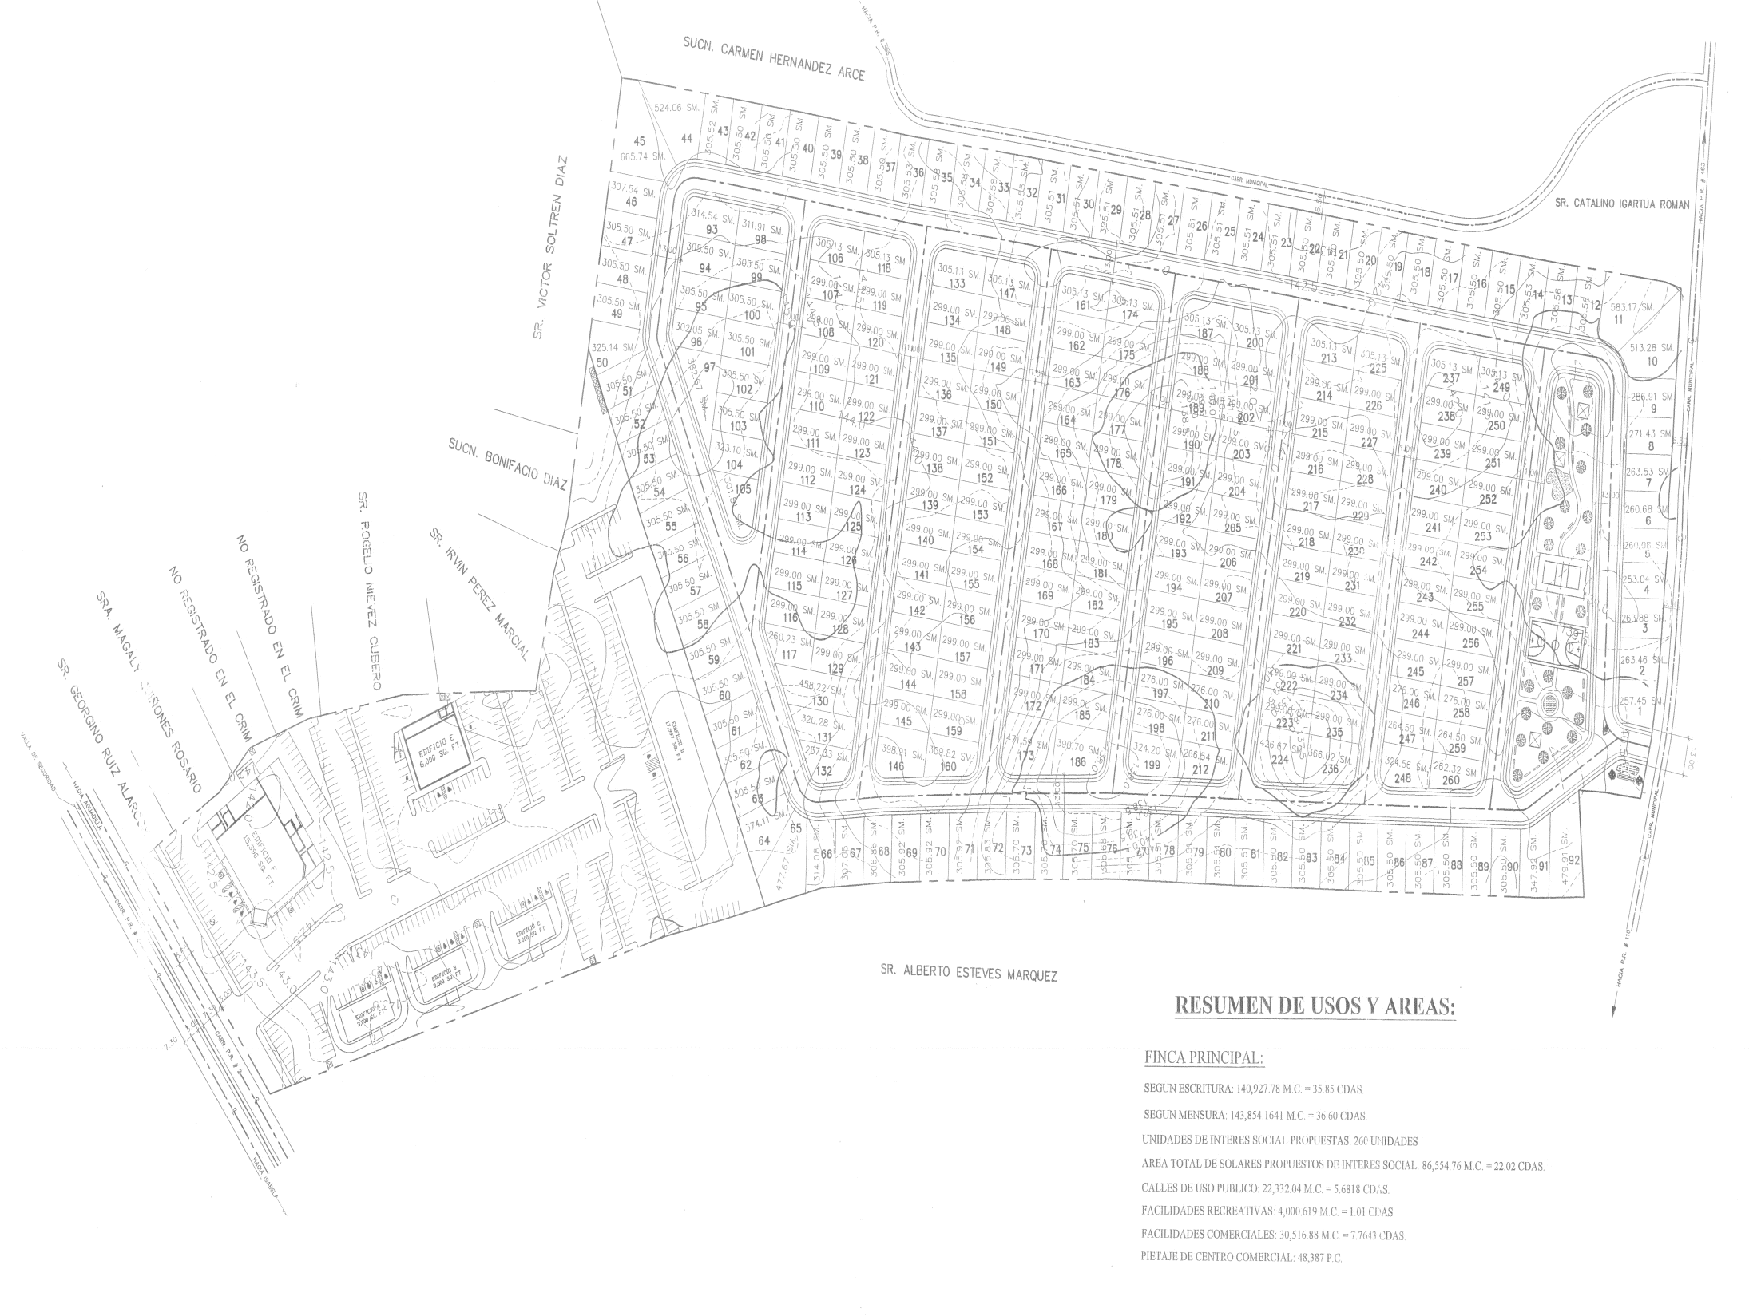

Slide 7
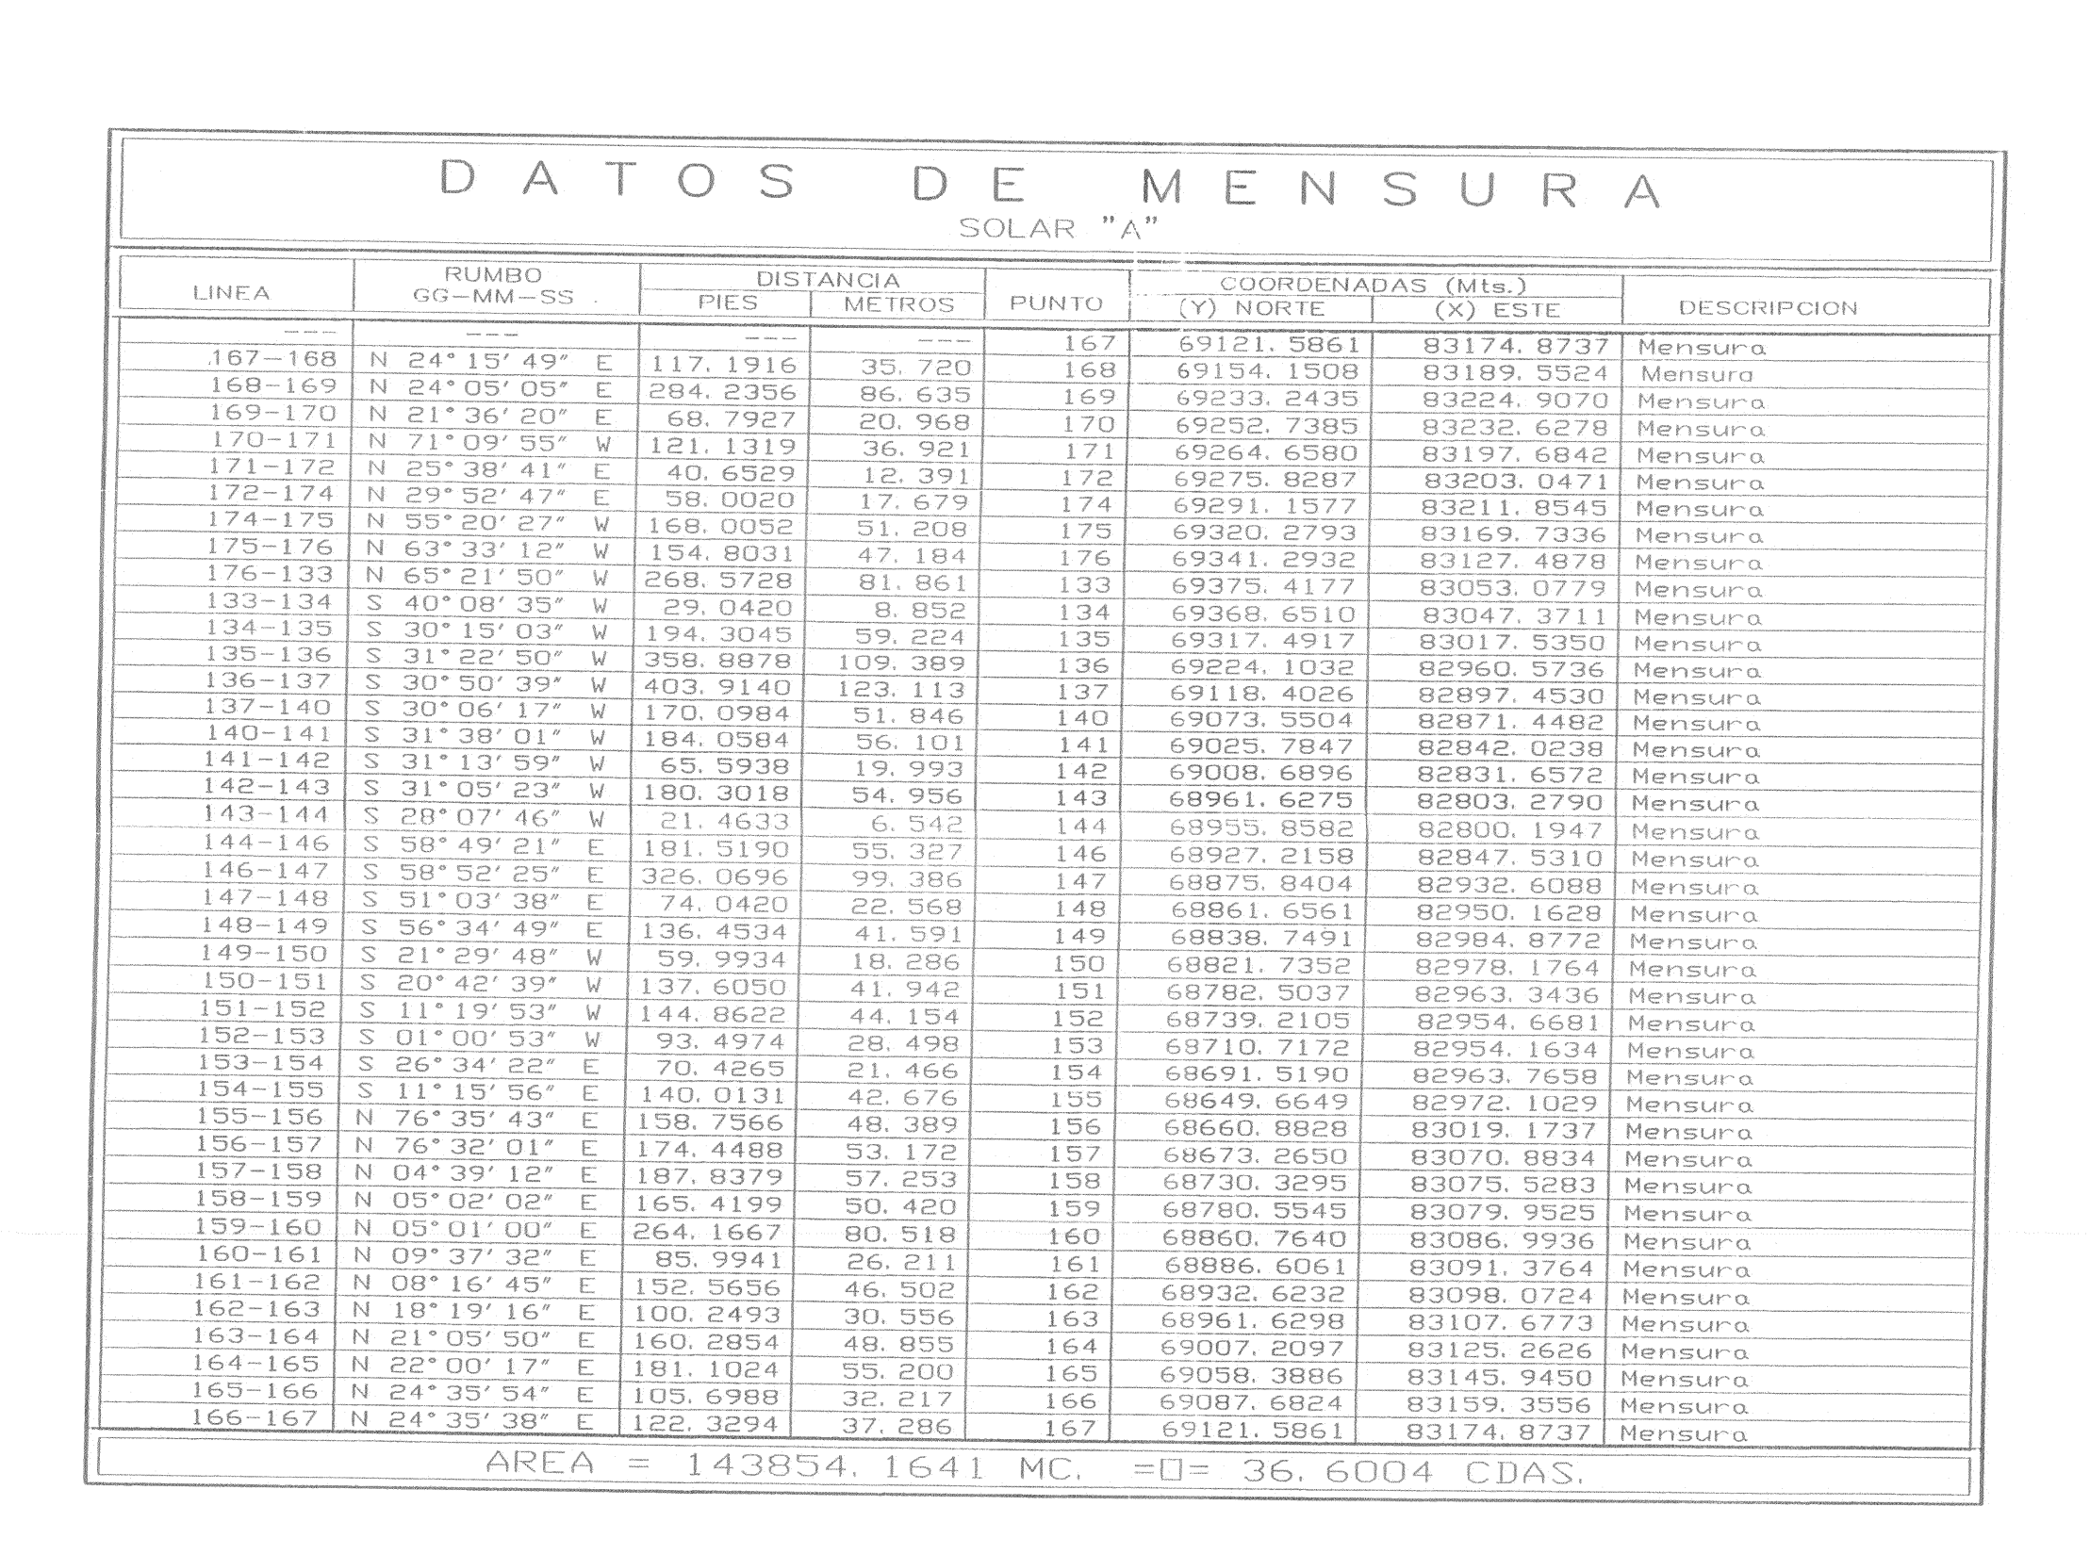

Slide 9
Government development bank – (GDB)
Owners
Private Banks
PRICE AVAILABLE UPON REQUEST

Slide 10
Property Features
Faces the #2 major highway
Close to retail store and malls
Segregated into 2 lots (4.47 & 32.82 cds)
Access to Three Major Internationals Airports
Close to Major Universities
Possible Project Developments: Hotels, Casinos, Retail Businesses,Condo-Hotels, Resorts, Residential Gated or Non- gated Communities

Slide 11
