Slide 1
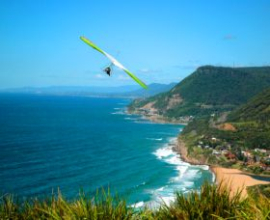
Barrio Maleza Alta
‘’The Enchanted Island’’
Aguadilla, Puerto Rico

Slide 2
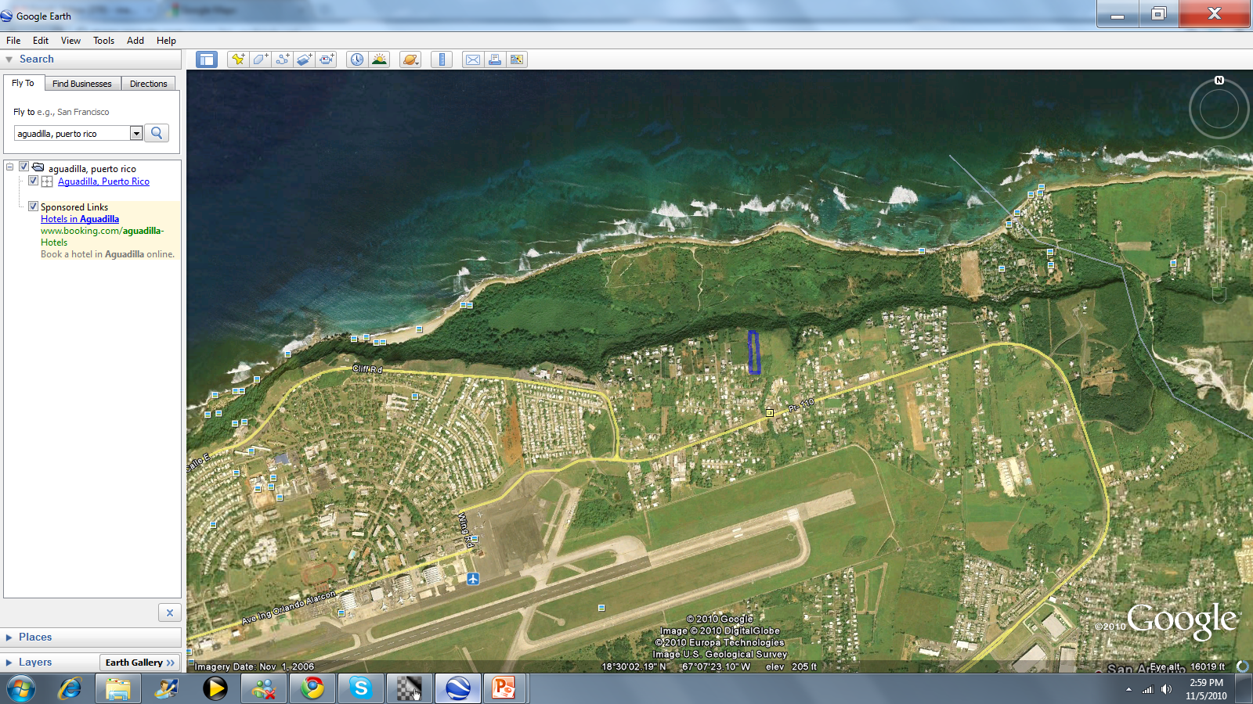

Slide 3
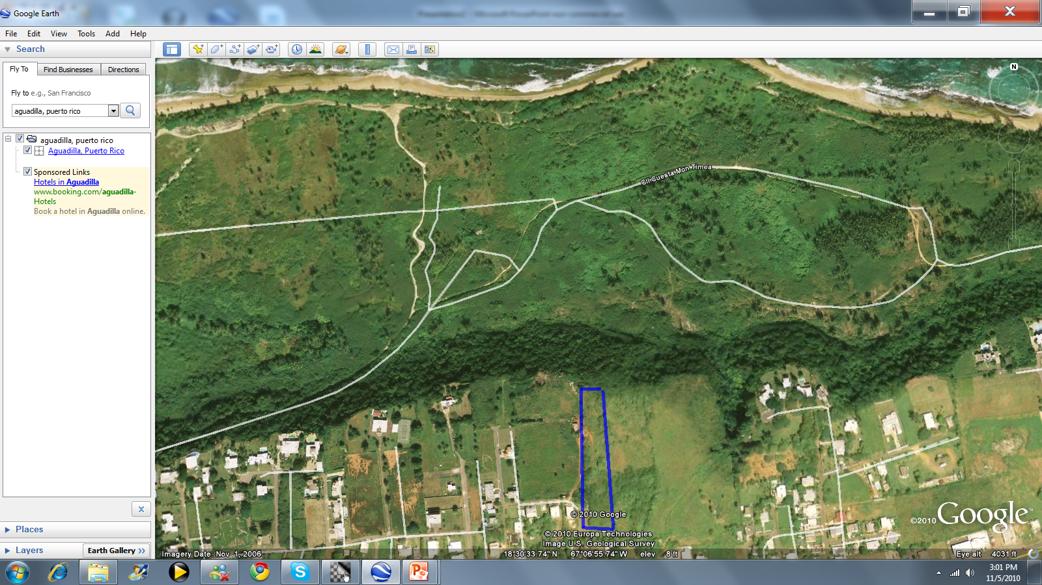

Slide 4
Size - The property is 2.5 “cuerdas” ( approximately 3 acres).
Dimensions - The length is 723 feet x width 137 feet.
Zoning - Residential
Permits - None at the moment. As of January 2010, a new law was approved to streamline and expedite the permit process.
Actual use - Vacant – raw land.
Best use - Tourist – residential development.
Facilities- Adjacent to the property.

Slide 5
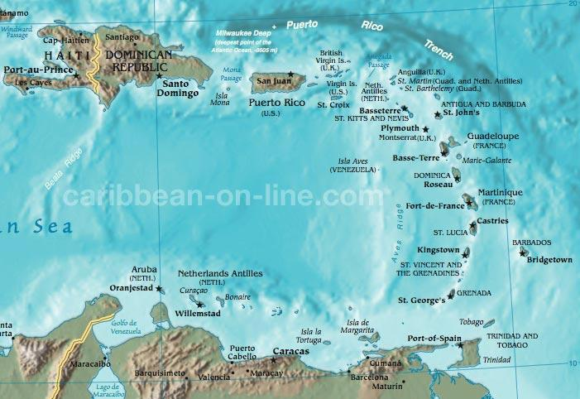

Slide 6
PORTA DEL SOL Tax Incentives
Up to 90% exemption on income tax
Up to 90% exemption on property tax
Up to 100% exemption on construction tax
Up to 100% exemption on municipal tax
Up to 100% exemption on excise tax

Slide 7
FINANCING AVAILABLE
Government development bank
Owners
Private Banks
PRICE AVAILABLE UPON REQUEST

Slide 8
COMPARABLES
Joyuda 7 acres - $5M
Combate 6.3 acres - $3.5M
La Parguera 4,482 meters - $120K
Cabo Rojo .61 acres - $1.8M
Rio Mar Beach 10.76 acres - $23.7M
Rio Mar Beach 4.55 acres - $13.6M
Rio Mar Beach .96 acres - $2.4M
Rio Mar Beach 6.12 acres - $18.5M
Santurce .23 acres - $1.3M

Slide 9
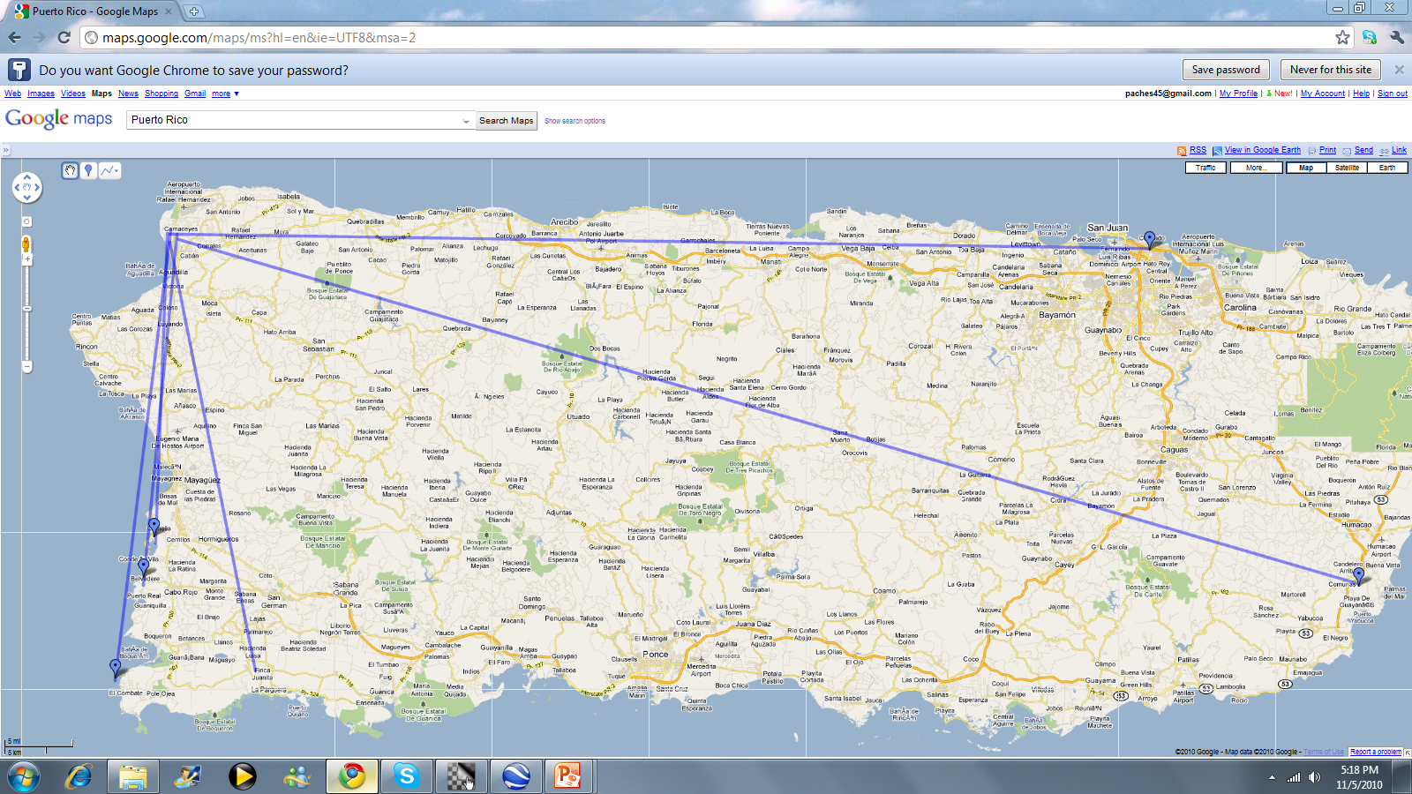
Comparable to site distance
Santurce
77 miles to
Aguadilla
SITE
Aguadilla
Joyuda
22 miles
to Aguadilla
Cabo Rojo
26 miles to
Aguadilla
Rio mar beach
96 to Aguadilla
Cambate
33 miles to
Aguadilla
La Parguera
32 miles to Aguadilla

Slide 10
Property Features
180 degrees beautiful ocean view from the property cliff, 200 feet above sea level.
Access to Three Major Airports- 5 minutes to Ramey Base airport.
Close to Major Universities
Possible Project Developments: Hotels, Casinos, Retail Businesses, Condo-Hotels, Resorts, Residential Gated Communities…

